Slide 1


Slide 2
Colorectal Cancer
NordICC at 10 years: Screening Colonoscopy is Dead! Long-live Screening Colonoscopy!
The quest for maximal ADR: Saving lives or overdiagnosis?
Artificial Intelligence and Colonoscopy Quality: Problem solved (not solved)
Douglas Corley, MD, PhD
Kaiser Permanente, San Francisco Medical Center
Director of Delivery Science & Applied Research, The Permanente Medical Group

Slide 3
How do screening tests save lives?
Part I
Screen
Pre-Symptom
Diagnosis
Effective
Treatment
Lower
Incidence & Mortality
Colonoscopy
(also for prevention)
Fecal Blood Tests
& Sigmoidoscopy
& Colonoscopy
Colonoscopy
(for prevention &
decreasing incidence)

Slide 4
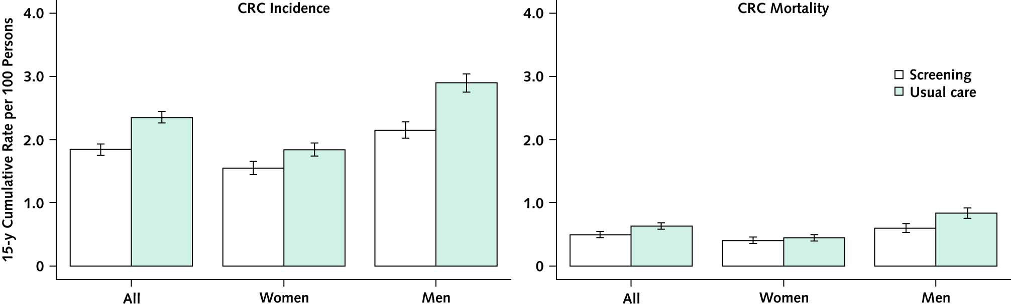
Colorectal Cancer Screening Works:
RCTs of Sigmoidoscopy and Fecal Blood testing
Part I
Pooled Randomized Sig Trials at 15 years:
21% lower incidence & 20% lower mortality
Via next-step colonoscopy
Juul et al. Ann Int Med 2022
Notes:
Analyses comprised 274 952 persons (50.7% women), 137 493 in the screening and 137 459 in the usual care group. Screening attendance was 58% to 84%. After 15 years, the rate difference for CRC incidence was 0.51 cases (95% CI, 0.40 to 0.63 cases) per 100 persons and the IRR was 0.79 (CI, 0.75 to 0.83). The rate difference for CRC mortality was 0.13 deaths (CI, 0.07 to 0.19 deaths) per 100 persons, and the MRR was 0.80 (CI, 0.72 to 0.88). Women had less benefit from screening than men for CRC incidence (IRR for women, 0.84 [CI, 0.77 to 0.91]; IRR for men, 0.75 [CI, 0.70 to 0.81]; P = 0.032 for difference) and mortality (MRR for women, 0.91 [CI, 0.77 to 1.17]; MRR for men, 0.73 [CI, 0.64 to 0.83]; P = 0.025 for difference). There was no statistically significant difference in screening effect between persons aged 55 to 59 years and those aged 60 to 64 years.

Slide 5
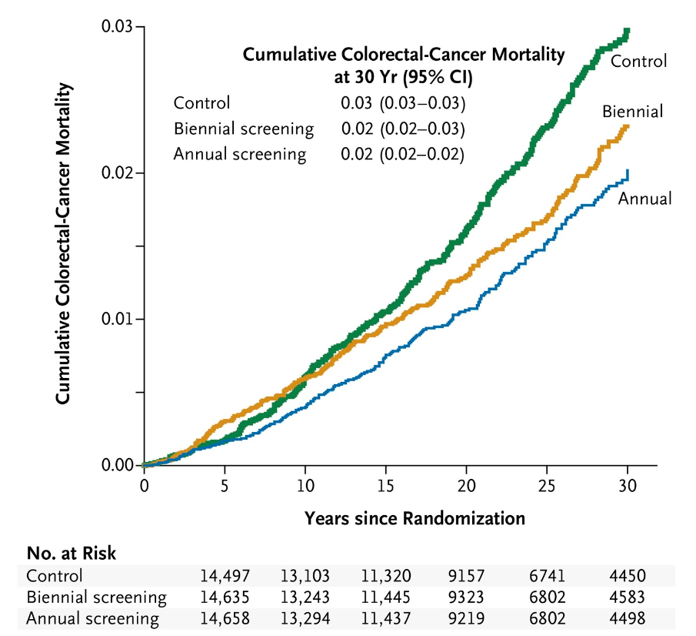
Fecal blood tests also work – via colonoscopy next step diagnosis/treatment
Part I
Shaukat et al NEJM 2013
Notes:
METHODS
In the Minnesota Colon Cancer Control Study, 46,551 participants, 50 to 80 years of age, were randomly assigned to usual care (control) or to annual or biennial screening with fecal occult-blood testing. Screening was performed from 1976 through 1982 and from 1986 through 1992. We used the National Death Index to obtain updated information on the vital status of participants and to determine causes of death through 2008.
RESULTS
Through 30 years of follow-up, 33,020 participants (70.9%) died. A total of 732 deaths were attributed to colorectal cancer: 200 of the 11,072 deaths (1.8%) in the annual-screening group, 237 of the 11,004 deaths (2.2%) in the biennial-screening group, and 295 of the 10,944 deaths (2.7%) in the control group. Screening reduced colorectal-cancer mortality (relative risk with annual screening, 0.68; 95% confidence interval [CI], 0.56 to 0.82; relative risk with biennial screening, 0.78; 95% CI, 0.65 to 0.93) through 30 years of follow-up. No reduction was observed in all-cause mortality (relative risk with annual screening, 1.00; 95% CI, 0.99 to 1.01; relative risk with biennial screening, 0.99; 95% CI, 0.98 to 1.01). The reduction in colorectal-cancer mortality was larger for men than for women in the biennial-screening group (P=0.04 for interaction).
CONCLUSIONS
The effect of screening with fecal occult-blood testing on colorectal-cancer mortality persists after 30 years but does not influence all-cause mortality. The sustained reduction in colorectal-cancer mortality supports the effect of polypectomy. (Funded by the Veterans Affairs Merit Review Award Program and others.)

Slide 6
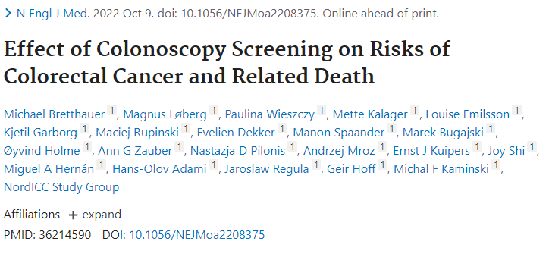
The title perhaps should have said…
Part I
Invitation to
Only about 40% accepted
the invitation

Slide 7
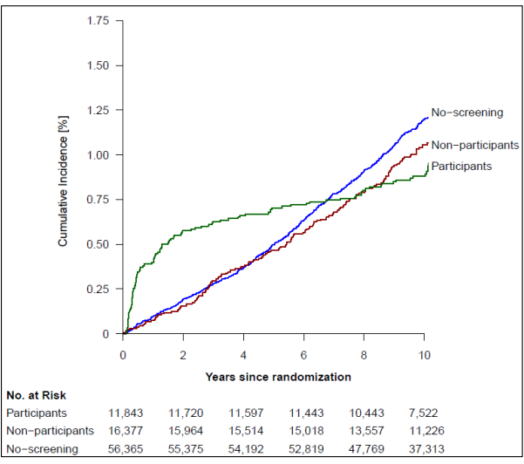
Those who accepted screening appeared higher risk and their risk was “flat” post-screening
Part I
Incidence
RR 0.82 (.70-.93)
Mortality
RR 0.90 (0.64-1.16)
NNT incid 455
All cause
RR 0.99 (0.96-1.04)

Slide 8
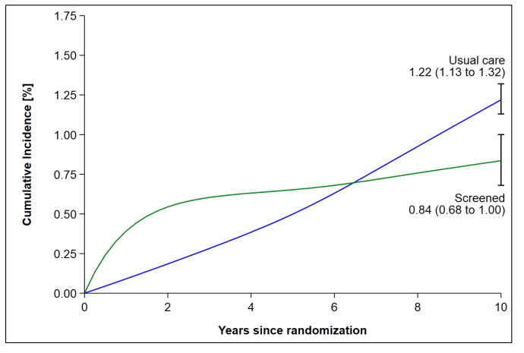
Adjusted per-protocol analysis suggested effectiveness among those screened
Part I
Per Protocol estimated
Incidence RR 0.69 (.55-83)
For PREVENTION Should Exclude
Baseline Cancers for Both Groups

Slide 9
Cumulative Incidence – Eliminating Cancers That Couldn’t be Prevented by Polypectomy
Part I

Slide 10
Mortality pattern similar to expected in adjusted analysis per protocol
Part I
Mortality Evaluation
  Too short (need 15 years)
  Too small (incidence lower than expected)
Incidence Evaluation underestimate
  needed to exclude prevalent CAs
Effectiveness, not efficacy
  Efficacy main interest to patients
Per Protocol Mortality RR 0.5 (.27-77)

Slide 11
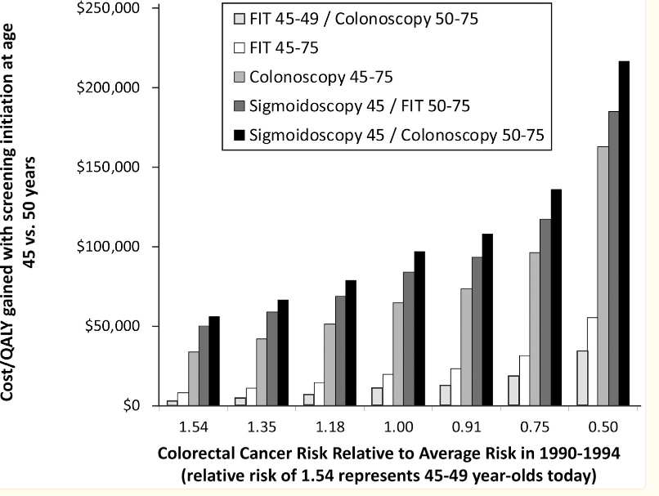
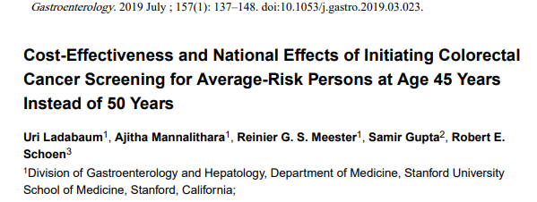
Extrapolating to a lifetime can be of help
Part I

Slide 12
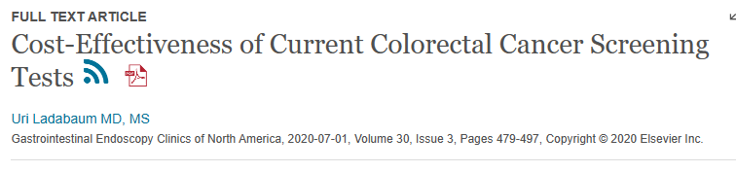
Multiple long-term models with best-available data suggest benefit
Part I
“Multiple cost-effectiveness analyses of colorectal cancer (CRC) screening performed around the world under a wide range of assumptions suggest that all CRC screening modalities are highly cost-effective”

Slide 13
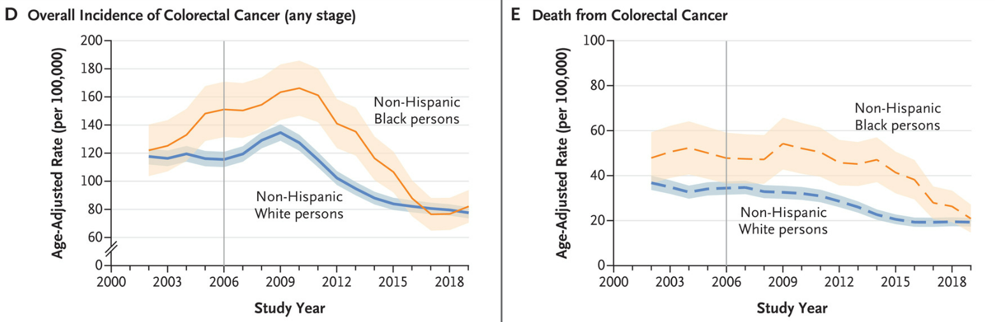
Increased CRC Screening Associated With Marked Reductions in CRC Incidence, Mortality & Disparities
Part I
Doubeni & Corley, NEJM 2022

Slide 14
The quest for maximal ADR: Saving lives
Part 2

Slide 15
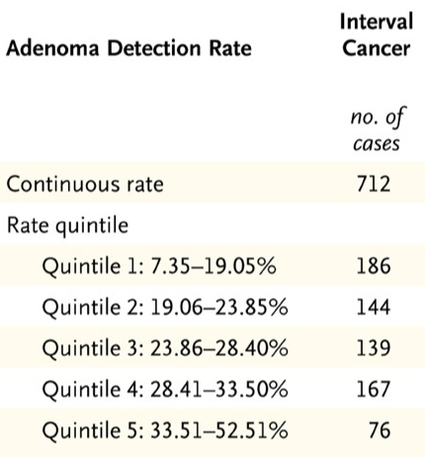
Decreased risk of cancer death
Part 2
Corley, NEJM 2014

Slide 16
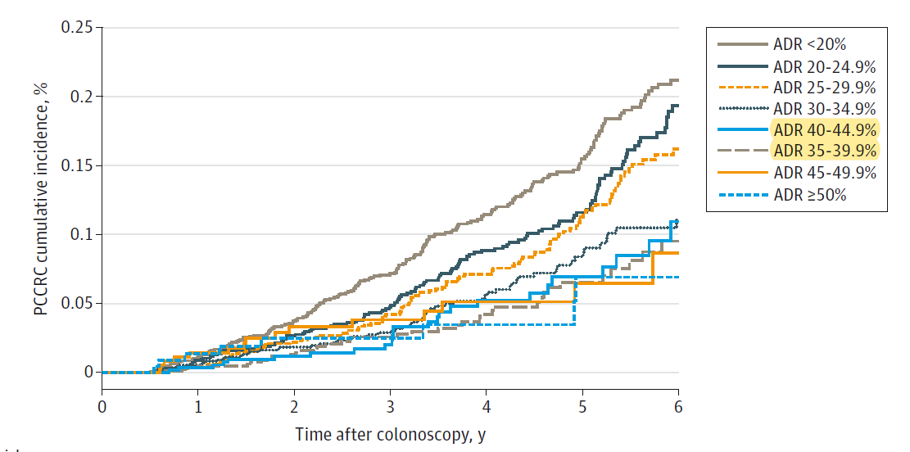
There is strong association of post-polyp risk by physician ADR, especially at lower ADRs
Part 2
852K colos, 2.4 mill py
Median f/up 3.25 yrs
619 CRC, 36 deaths
Per 1% ADR, 3% incid, 5% death
JAMA, PROSPR consortium, 2022

Slide 17
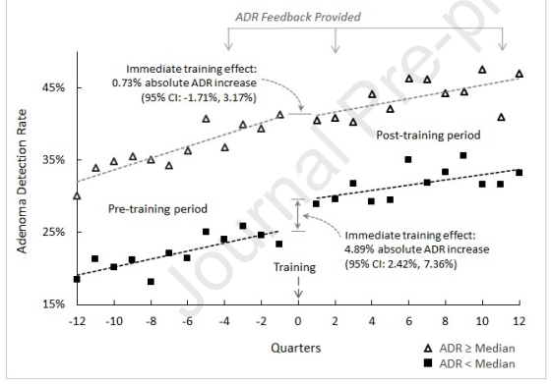
Question: Can a colonoscopy quality feedback plus a regional training decrease variation and improve patient outcomes?
Part 2
30 minute, free interactive, online
  www.kp.org/DARE
Improved adenoma detection 25% to 40%
Prompt 3.13% increase average (95% CI 1.3-4.9)
  Higher for lower detectors - 5% increase
Decreased variation
High value decrease CRC morbidity/cost
  Overall >50% fewer post-colo CRC
  Likely >100 cancer fewer/3 yrs, >$10 million
ADR increase of ≥10% vs. <1% was associated with a 55% reduced relative risk of PCCRC (HR: 0.45, 95%CI: 0.24-0.82)
  Not associated with starting ADR*
Corley, Lee, Jensen, Gastro 2023
Notes:
A prior KPNC study found that, consistent with other national and international studies, there was variation between examiners within KPNC on the likelihood of finding and removing pre-cancerous polyps.
Assumptions of $100K per cancer (using costs 80K from 10 years ago, inflated modestly to today’s dollars, assuming early period pre-training cancers twice as common as 93 cancers detected post-training (which had maximum 3 years f/up)

Slide 18
Modeling a lifetime:
Higher ADRs/Quality has a big impact
Part 2
Meester, JAMA 2015
Notes:
Working with the CISNET modeling group, including Ann Zauber at Memorial Sloan Kettering and the Erasmus modeling group, using a model that informed the US preventative services task force guidelines. We took real world data on adenoma detection and interval cancer rates to create a large cohort simulation of what would happen if you follow people to death.
If you compare it to no screening, approximately 1/3 of the total maximum theoretical benefit of colonoscopy is related to quality.

Slide 19
Increasing ADR increases number of exams, but not as many as we might think
Part 2
Meester, JAMA 2015
Notes:
Not as many as we might thing – only about 15-20% of the populations will be getting more colonoscopies and some of these “replace” screening exams

Slide 20
Overall increasing ADR is likely win:win:win for incidence, mortality, cost with minimal effort
Part 2
Meester, JAMA 2015

Slide 21
Artificial Intelligence and Colonoscopy Quality: Problem *not* solved
Part 3
Beware unexpected consequences

Slide 22
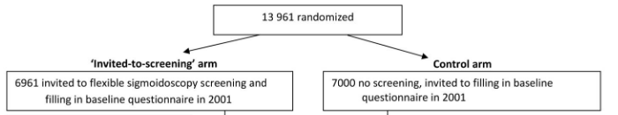

More is better vs. unexpected consequences
Part 3

Slide 23
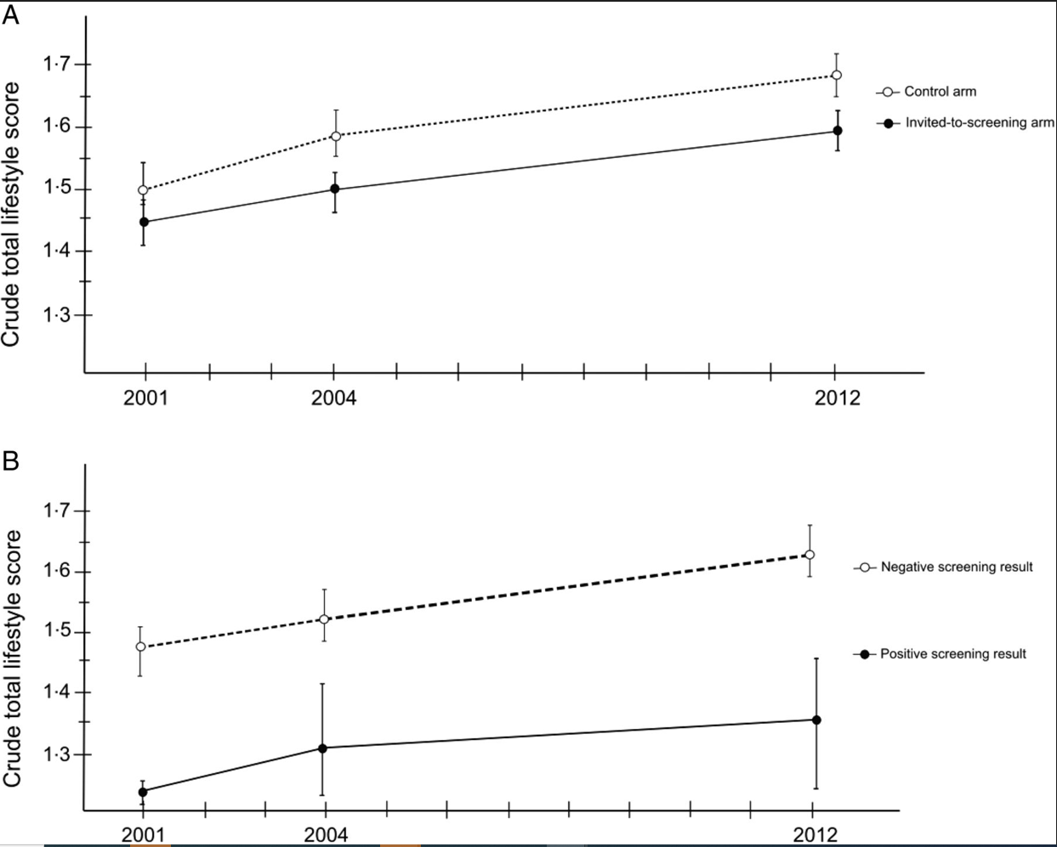
Invitation to screening had adverse effect on other behaviors
Part 3
At 3 years:
More weight gain
Less smoking cessation
Poorer exercise habits
Lower increase in good diet
Difference persisted at 11 years
Berstad, Gut, 2015 and
Larsen CGH 2007 and
Notes:
We created a total lifestyle score based on adherence to international and national public health recommendations from the WHO,¹⁷ ,¹⁸ World Cancer Research Fund,¹⁹ the Nordic Nutrition Recommendations²⁰ and the Norwegian dietary recommendations.²¹ In order to classify the study participants according to these recommendations within the limits of the questionnaire, one point was given for each of the following criteria: normal body weight (BMI<25.0 kg/m²),¹⁷ ,¹⁹ ,²⁰ non-smoking,¹⁸ physical activity at least once per day¹⁷ ,¹⁹ and a healthy diet. For the healthy diet, participants achieved one point if reporting all the three dietary habits: (1) consumption of fruit, berries and vegetables with at least five servings per day;¹⁷ ,¹⁹ ,²⁰ (2) consumption of fatty fish at least once per week²⁰ and (3) consumption of meat other than poultry for dinner maximum three times per week (according to recommendation of consumption of red and processed meat <500 g per week¹⁹ ,²¹). Hence, the total lifestyle score ranged from zero to four points, indicating the number of lifestyle recommendations adhered to by the individual.
This study shows that overall adherence to lifestyle recommendations increased in our large sample of 50-year-old to 55-year-old Norwegian men and women from year 2001 until 2012. Invitation to screening had a small negative long-term effect on total lifestyle score, supporting the health certificate effect of cancer screening.⁵ Furthermore, the apparently less favourable total lifestyle change after CRC screening was more pronounced in screening attendees with a positive than negative screening result

Slide 24
Does this apply to AI? Imagine 400 people getting a colonoscopy
Part 3
Adenoma detection has two parts – here an “extra” 25 people have an adenoma detected by AI and an “extra” 50 by endoscopist
Total is 200/400
ADR is 50%
Detected by Endoscopist
Detected by AI
50
25
125

Slide 25
Does this apply to AI? What if AI made the endoscopist less attentive for their component?
Part 3
Here an “extra” 75 people have an adenoma detected by AI and an “extra” 25 by endoscopist
Total is 150/400
ADR is 37.5%
Even lower if visualization techniques deteriorate and impact AI
Detected by Endoscopist
Detected by AI
75
25
75

Slide 26
In real life use, no clear benefit in large trial
769 patients (one of largest)
4 Centers
Pragmatic trial – was or was not used in colonoscopy
“studies are needed to better understand why some endoscopists derive substantial benefits from CADe and others do not”
Wei, 2023, AJG
Notes:
NTRODUCTION:
There has been increasing interest in artificial intelligence in gastroenterology. To reduce miss rates during colonoscopy, there has been significant exploration in computer-aided detection (CADe) devices. In this study, we evaluate the use of CADe in colonoscopy in community-based, nonacademic practices.
METHODS:
Between September 28, 2020, and September 24, 2021, a randomized controlled trial (AI-SEE) was performed evaluating the impact of CADe on polyp detection in 4 community-based endoscopy centers in the United States Patients were block-randomized to undergoing colonoscopy with or without CADe (EndoVigilant). Primary outcomes measured were adenomas per colonoscopy and adenomas per extraction (the percentage of polyps removed that are adenomas). Secondary end points included serrated polyps per colonoscopy; nonadenomatous, nonserrated polyps per colonoscopy; adenoma and serrated polyp detection rates; and procedural time.
RESULTS:
A total of 769 patients were enrolled (387 with CADe), with similar patient demographics between the 2 groups. There was no significant difference in adenomas per colonoscopy in the CADe and non-CADe groups (0.73 vs 0.67, P = 0.496). Although the use of CADe did not improve identification of serrated polyps per colonoscopy (0.08 vs 0.08, P = 0.965), the use of CADe increased identification of nonadenomatous, nonserrated polyps per colonoscopy (0.90 vs 0.51, P < 0.0001), resulting in detection of fewer adenomas per extraction in the CADe group. The adenoma detection rate (35.9 vs 37.2%, P = 0.774) and serrated polyp detection rate (6.5 vs 6.3%, P = 1.000) were similar in the CADe and non-CADe groups. Mean withdrawal time was longer in the CADe group compared with the non-CADe group (11.7 vs 10.7 minutes, P = 0.003). However, when no polyps were identified, there was similar mean withdrawal time (9.1 vs 8.8 minutes, P = 0.288). There were no adverse events.
DISCUSSION:
The use of CADe did not result in a statistically significant difference in the number of adenomas detected. Additional studies are needed to better understand why some endoscopists derive substantial benefits from CADe and others do not. ClinicalTrials.gov number: NCT04555135.

Slide 27

Part 3
Ebbatson in 2010, pilots in simulator
Manually landed 737 using no automation “a rare request in today’s automation age”
Success strongly and inversely associated with time in recent flight logs on “auto-pilot”

Slide 28
Artificial Intelligence and Colonoscopy Quality: Problem *not* solved
Part 3
AI increases ADR
  Artificial settings (e.g. tandem exams), expert groups over short follow-up
Could it immediately or over time
  Decrease MD-part of ADR
    Reliance on AI, deteriorate exam & main ADR driver: visualization?
    Impede fellow training in adenoma detection
?No net effect or even harm?
  Wait large studies, over time, emphasize visualization

