Slide 2
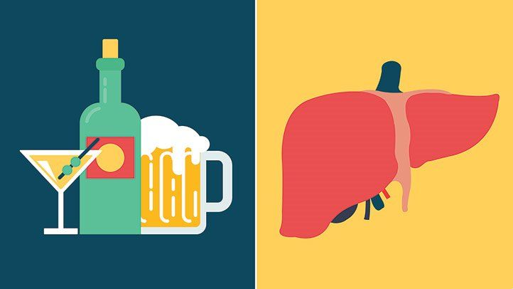
Management if Alcohol Associated Liver Disease
Marina Roytman MD, FACP
Clinical Professor, UCSF
Liver Program Director, UCSF Fresno

Slide 3
UCSF Fresno Hepatology Rounds circa 2022
28 F with escalating use of ETOH over previous few months
Multiple life stressors
1-2 glasses of wine → 1-2 bottles of wine
Stopped ETOH 2 weeks ago
Presented with jaundice, ascites
Mentation intact.
TB 24, albumin 3.1, AST 89, ALT 37, INR 2.4, platelets 97
Is this acute liver failure?
Is this decompensated cirrhosis?

Slide 4
How Much Alcohol is in a Drink?
Our patient
was consuming
5-10 American drinks
a day
Notes:
1 L = 22 shots
1 handle 1.75 L = 40 drinks

Slide 5
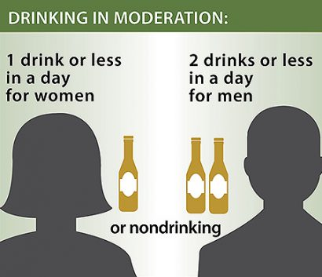
Public Health Aspects: How Much Alcohol is Safe?
Light–moderate intake: ↓ reduced risk of coronary artery disease. Or not?
Heavy chronic alcohol intake: ↑ risk of cardiomyopathy, hypertension, atrial arrhythmias and hemorrhagic stroke
Alcohol is a recognized carcinogen
No safe threshold established
Chronic use of alcohol is a risk factor for cirrhosis
Cessation of drinking at any point reduces risk of disease progression and occurrence of complications
Recommendation: Europe
≤2 standard drinks for women
≤3 for men.
= 20 g
= 30 g
Recommendation: US
= 14 g
= 28 g
EASL CPG ALD. J Hepatol 2018;69:154–81
https://www.dietaryguidelines.gov/resources/2020-2025-dietary-guidelines-online-materials
Notes:
Although past studies have indicated that moderate alcohol consumption has protective health benefits (e.g., reducing risk of heart disease), recent studies show this may not be true.⁶⁻¹¹ While some studies have found improved health outcomes among moderate drinkers, it’s impossible to conclude whether these improved outcomes are due to moderate alcohol consumption or other differences in behaviors or genetics between people who drink moderately and people who don’t.⁶⁻¹¹

Slide 6
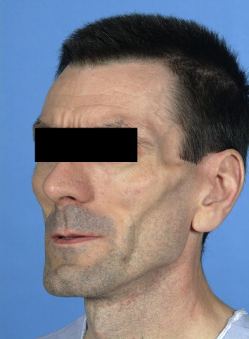
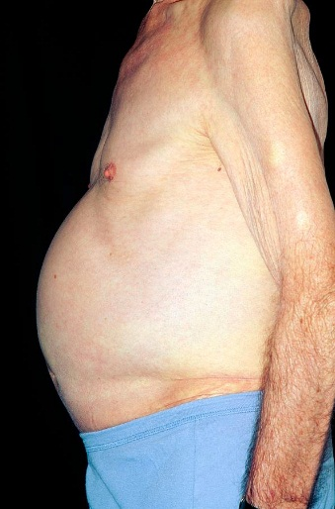
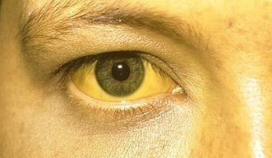
Alcohol-Related Hepatitis: Definition and Diagnosis
Clinical
Fever, malaise, weight loss and sarcopenia
Jaundice, ascites, hepatic encephalopathy
A recent onset of jaundice in patients with excessive ETOH consumption should prompt clinicians to suspect AH
Laboratory
Elevated WBC
Elevated bilirubin
AST >2 x ULN
AST/ALT ˃ 2.0
Severe: prolonged PT, low albumin, low platelets
EASL CPG ALD. J Hepatol 2018;69:154–81
Notes:
AH, alcoholic hepatitis; ALT, alanine aminotransferase; AST, aspartate aminotransferase; PT, prothrombin time; ULN, upper limit of normal

Slide 7
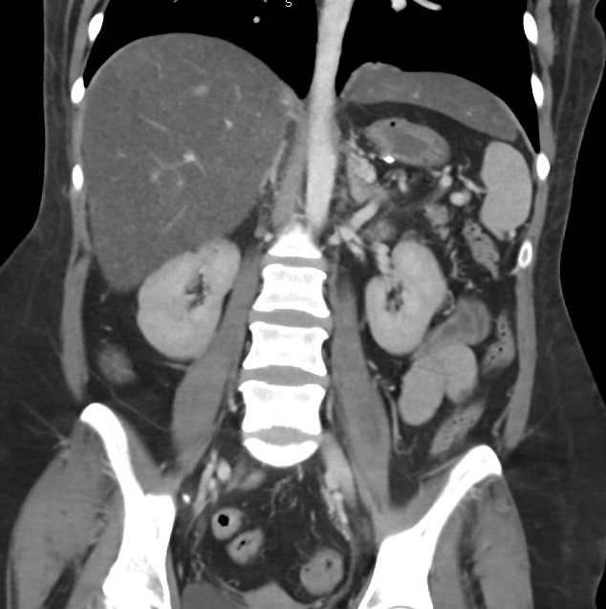
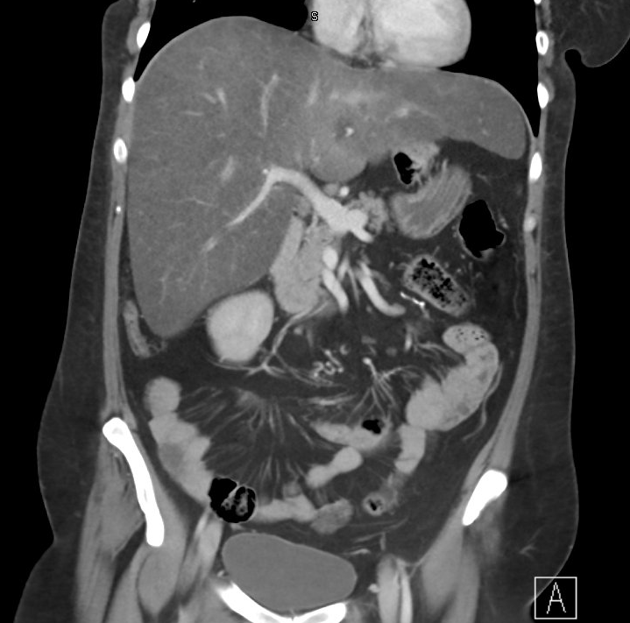
Diagnostic Tests in the Management of ALD: Imaging
US, MRI, CT
No role in establishing alcohol as the specific etiology of liver disease
May be useful for:
Quantification of steatosis
Exclusion of other causes of chronic liver disease
Assessment of advanced liver disease and its complications
EASL CPG ALD. J Hepatol 2018;69:154–81
Notes:
ALD, alcohol-related liver disease; CT, computed tomography; MRI, magnetic resonance imaging

Slide 8
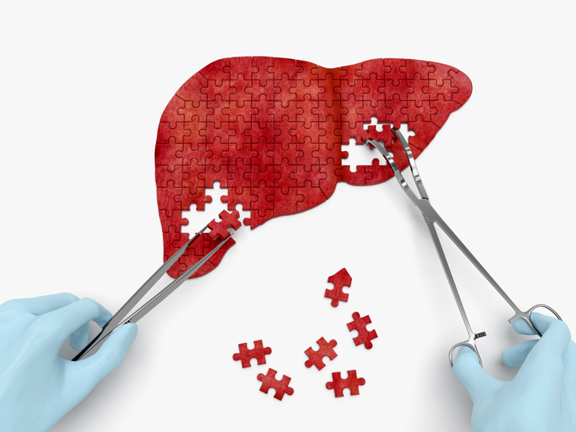
Do I Need a Liver Biopsy to Diagnose Alcohol-Related Hepatitis?
Liver biopsy may be used to:
Establish the definite diagnosis of ALD
Assess the exact stage and prognosis of liver disease
Exclude alternative or additional causes of liver injury
Liver biopsy is recommended:
In the setting of clinical trials
In case of inconclusive non-invasive test results
In case of any suspicion of a competing liver disease
Liver biopsy is not generally recommended for all patients with suspected ALD
Risks should be carefully weighed against the clinical benefits and therapeutic consequences
EASL CPG ALD. J Hepatol 2018;69:154–81
Notes:
ALD, alcohol-related liver disease

Slide 9
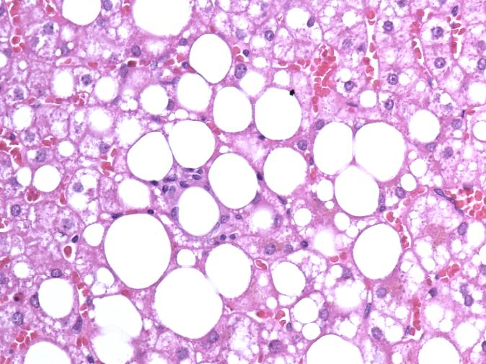
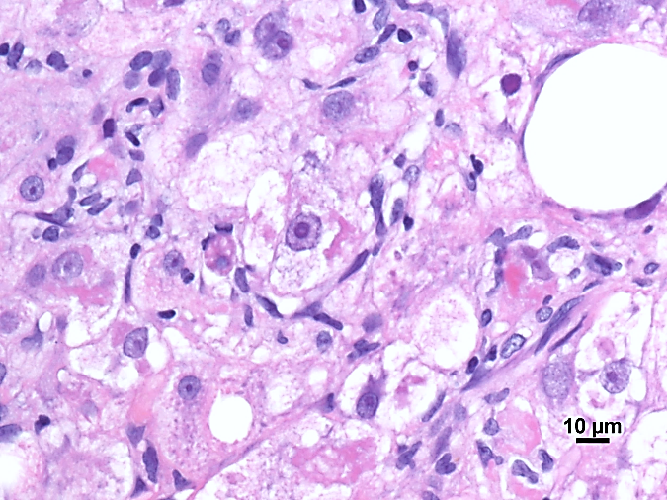
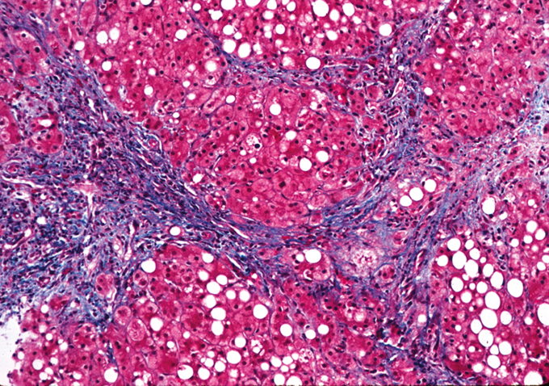
What will Liver Biopsy Show?
Alcoholic steatosis
Macro and eventually variable blend of macro- and microvesicles
Alcoholic steatohepatitis (ASH)
Variable degree of macrovesicular steatosis
Hepatocellular injury with ballooning, potentially necrosis
Lobular inflammation
Alcoholic fibrosis/cirrhosis
Pericellular and or septal fibrosis
Micronodular cirrhosis
A single lesion or any combination may be found in a given individual
Steatosis
Steatohepatitis
Cirrhosis
Images provided courtesy of Lackner C.
EASL CPG ALD. J Hepatol 2018;69:154–81
Notes:
ALD, alcohol-related liver disease; ASH, steatohepatitis due to alcohol-related liver disease

Slide 10
Alcohol-Related Hepatitis: Histology
Steatosis
Hepatocyte ballooning
Neutrophilic lobular inflammation
Mallory bodies
By Nephron - Own work, CC BY-SA 3.0, https://commons.wikimedia.org/w/index.php?curid=7815350

Slide 11
Direct Markers of Alcohol Consumption
Biomarker | Biological material | Detection window | EtOH amount | Sens. | Spec. | Confounding factors
EtOH | Serum | 4–12 hours
EtG | Urine | Up to 80 hours | >5 g | 89% | 99% | Increases results Accidental contamination of food, mouth wash, alcohol-free beer, etc. Decreases results: Urine dilution deliberately or by diuretics
EtG | Hair | ≤6 months | >20–40 g/d for >3 months | 85–92% | 87–97% | Increases results Seriously impaired renal function EtG containing hair treatment Decreases results Hair treatment: dying, perming, bleaching
EASL CPG ALD. J Hepatol 2018;69:154–81
Notes:
ALD, alcohol-related liver disease; EtG, ethyl glucuronide; EtOH, ethanol; UTI, urinary tract infection.

Slide 12
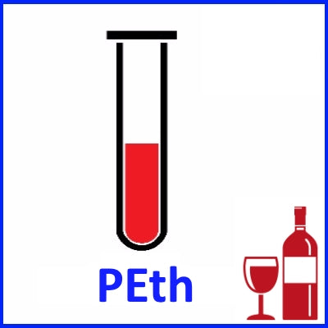
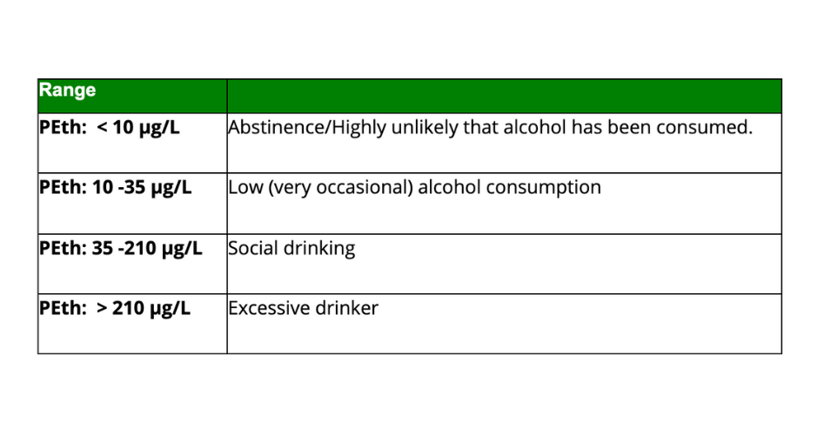
Direct Markers of Alcohol Consumption: PEth
Phosphatidylethanol (PEth)
Accumulates in RBCs
Direct biomarker
Half-life 3-5 days
Detectability 2-4 weeks

Slide 13
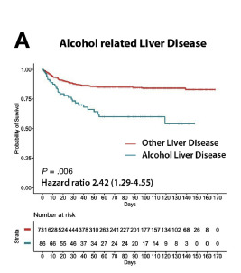
Predictors of Outcomes of COVID-19 in Patients with Chronic Liver Disease: US Multi-center Study
21 institutions in the US
867 patients with chronic liver disease and
COVID-19
March 1, 2020 – May 30, 2020
Predictors of mortality
Alcohol-related liver disease
Decompensated cirrhosis
Hepatocellular carcinoma
1/3 of patients with daily alcohol use
50% of patients with ALD reported daily alcohol consumption
Kim D, Roytman M. et al. Clin Gastroenterol Hepatol. 2020

Slide 14
Alcohol-Related Hepatitis at CMC during Early COVID-19 Pandemic
51% overall
increase in
incidence
69% increase
since
Stay-at-home
orders
Sohal, Roytman, J Clin Gastroenterol 2021
Notes:
2019 = 131 p= 0.0028
2020 = 189

Slide 15
Admissions Remain High in the Second Year of Pandemic
2019: 131
2020: 201
53%
2021: 215
64%
Sohal, Roytman, presented at the AASLD Liver Meeting 2022

Slide 16
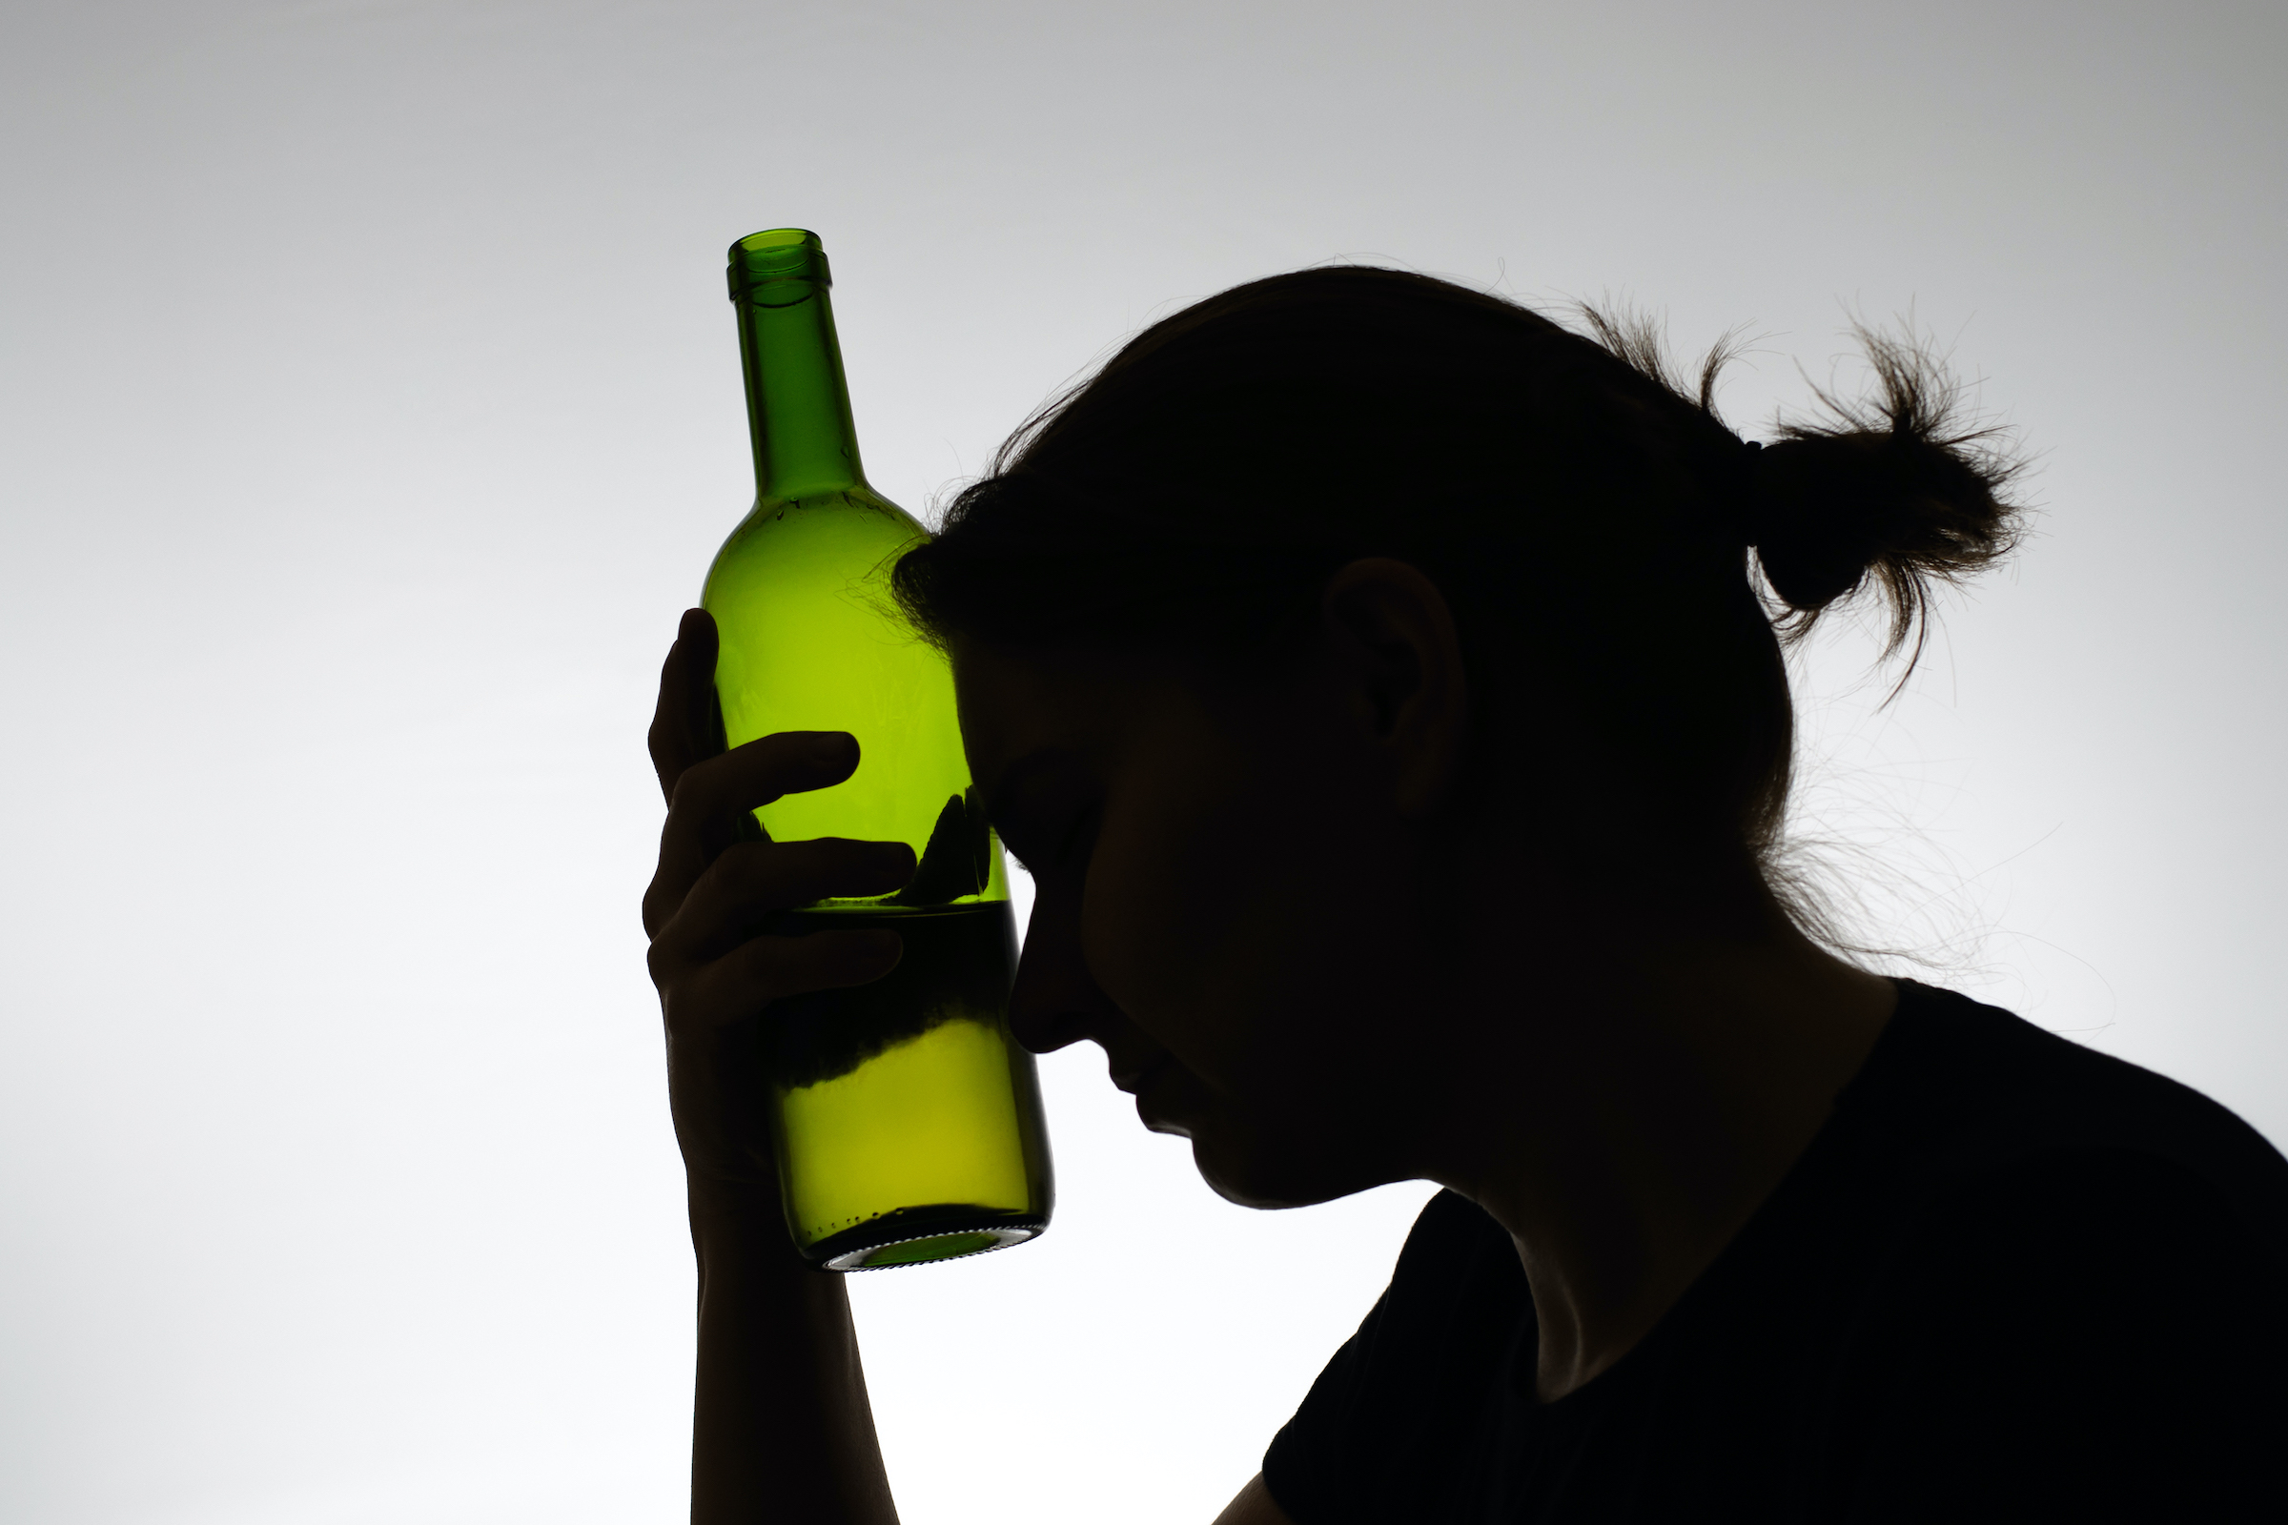
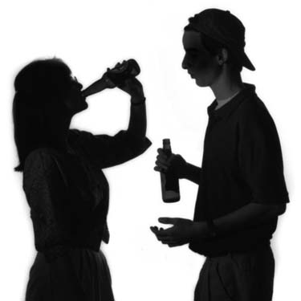
Concerning Trends in Women and Young Patients Continue in the 2nd Year of the Pandemic
Women
2019: 24
2020: 55 = 129%
2021: 67 = 179 %
Patients under 40
2019: 30
2020: 61 = 103%
2021: 71 = 136 %
Sohal, Roytman, presented at the AASLD Liver Meeting 2022

Slide 17
Re-admission Rate as Indicator of Disease Severity
Sohal, Roytman, presented at the AASLD Liver Meeting 2022

Slide 18
A Brewing Pandemic on a National Level
National Inpatient Sample Database
823,145 patients
AAPC
Women: 5% to 14.2%
18-44 year olds 6.9% to 19.8%
Sohal, Roytman, presented at DDW Meeting 2023
Notes:
AAPC – average annual percent change

Slide 19
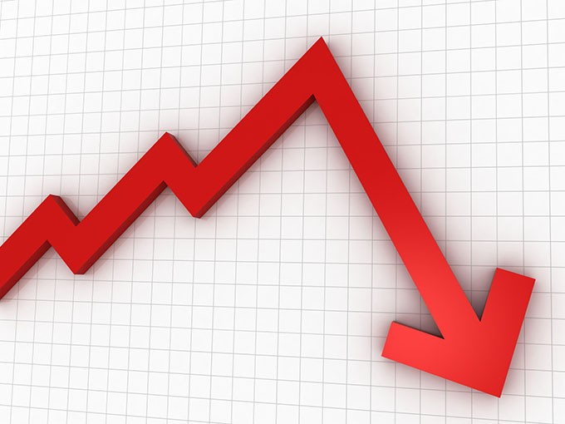
A Perfect Storm:
MENTAL HEALTH
Increased depression
and anxiety
SHELTER IN PLACE
Easy access,
lack of diversion
ACCESS TO CARE
Decreased access
to medical care
ECONOMY
Job loss, stress,
isolation
Kim D, Roytman M. et al. Clin Gastroenterol Hepatol. 2020

Slide 20
Effect of increased alcohol consumption during COVID‐19 pandemic on alcohol‐associated liver disease: A modeling study
8,000 additional ALD-related deaths
18,700 cases of decompensated cirrhosis
1,000 cases of HCC
8.9 million disability-adjusted life-years between 2020 and 2040
Julien, et al. Hepatology 2021

Slide 21
We are Going to Need to Know How to Manage ALD…
Clinical diagnosis of AH
Treatment of alcohol dependence
Consider liver biopsy if diagnosis is uncertain
Systematic evaluation of nutritional status and energy intake
Daily target 35–40 kcal/kg BW
Prefer oral route as first-line intervention
Perform systematic screening for infection
Assessment of disease severity
mDF ≥32 or MELD >20
mDF <32 and MELD <20
Prednisolone 40 mg/day ± NAC
Assess treatment response at Day 4 (Lille score)
Lille score <0.45
Lille score ≥0.45
Continue treatment for 28 days
Stop prednisolone and assess for early liver transplantation in highly selected patients
EASL CPG ALD. J Hepatol 2018
Notes:
AH, alcoholic hepatitis; BW, body weight; GAHS, Glasgow alcoholic hepatitis score; mDF, modified Maddrey discriminant function; NAC, N-acetylcysteine

Slide 22
Alcohol-Related Hepatitis: Evaluation of Severity
Score | Bilirubin | PT/INR | Creatinine/ urea | Leucocytes | Age | Albumin | Change in bilirubin (Day 0 to 7)
Maddrey DF* | + | + | – | – | – | – | –
MELD | + | + | + | – | – | – | –
GAHS | + | + | + | + | + | – | –
ABIC | + | + | + | – | + | + | –
Lille | + | + | + | – | + | + | +
First score and still most widely used
EASL CPG ALD. J Hepatol 2018
Notes:
ABIC, age, serum bilirubin, INR, and serum creatinine score; AH, alcoholic hepatitis; GAHS, Glasgow Alcoholic Hepatitis Score; INR, international normalized ratio; Maddrey DF, Maddrey discriminant function; MELD, Model for End-Stage Liver Disease; PT, prothrombin time

Slide 23
Alcohol-Related Hepatitis: Evaluation of Severity
Score | Bilirubin | PT/INR | Creatinine/urea | Leucocytes | Age | Albumin | Change in bilirubin (Day 0 to 7)
Maddrey DF* | + | + | – | – | – | – | –
MELD | + | + | + | – | – | – | –
GAHS | + | + | + | + | + | – | –
ABIC | + | + | + | – | + | + | –
Lille | + | + | + | – | + | + | +
Score >20: high risk of 90-day mortality
EASL CPG ALD. J Hepatol 2018
Notes:
ABIC, age, serum bilirubin, INR, and serum creatinine score; AH, alcoholic hepatitis; GAHS, Glasgow Alcoholic Hepatitis Score; INR, international normalized ratio; Maddrey DF, Maddrey discriminant function; MELD, Model for End-Stage Liver Disease; PT, prothrombin time

Slide 24
Alcohol-Related Hepatitis: Treatment Response
Score | Bilirubin | PT/INR | Creatinine/urea | Leucocytes | Age | Albumin | Change in bilirubin (Day 0 to 7)
Maddrey DF* | + | + | – | – | – | – | –
MELD | + | + | + | – | – | – | –
GAHS | + | + | + | + | + | – | –
ABIC | + | + | + | – | + | + | –
Lille | + | + | + | – | + | + | +
Score of ≥0.45 indicates non-response to corticosteroids
EASL CPG ALD. J Hepatol 2018
Notes:
ABIC, age, serum bilirubin, INR, and serum creatinine score; AH, alcoholic hepatitis; GAHS, Glasgow Alcoholic Hepatitis Score; INR, international normalized ratio; Maddrey DF, Maddrey discriminant function; MELD, Model for End-Stage Liver Disease; PT, prothrombin time

Slide 25
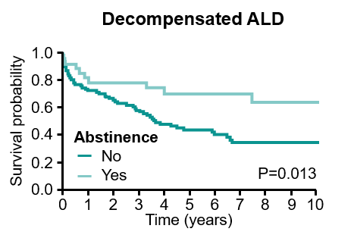
Encourage and Support Abstinence!
Abstinence is critical!
Pharmacological treatments for AUD show modest results
Management of the addictive process is the most relevant aspect of treatment
Everything AA
Lackner C, et al. J Hepatol. 2017;66:610−8
EASL CPG ALD. J Hepatol 2018;69:154–81

Slide 26
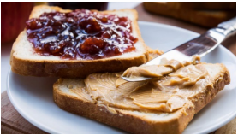
Nutrition
Food | Serving | Protein
Chicken | 6 oz | 36 g
Salmon | 6 oz | 34 g
Egg | 1 | 6 g
Peanuts | 6 oz | 12 g
Protein/energy malnutrition is present in almost every patient with severe AH poor prognosis
Tube feeding is strongly recommended if patients are not able to maintain adequate oral intake
≥35–40 kcal/kg/day and 1.2–1.5 g/kg/day protein
Bedtime snack!
80 kg patient needs 96-120 g of protein a day

Slide 27
Optimal Timing of Energy Intake: Bedtime Snack
↑breakdown of
skeletal muscle
to meet amino
acids needs
↓ gluconeogenesis
protein-calorie
malnutrition
Metabolic profile of a
patient with cirrhosis after
an overnight fast
Metabolic profile of a
healthy person after
3 says of starvation

Slide 28
STeroids Or Pentoxifylline for Alcoholic Hepatitis
P value 0.06
Thursz, NEJM 2015
Notes:
1100 patients
Mortality at 28 days, 90 days and 1 year

Slide 29
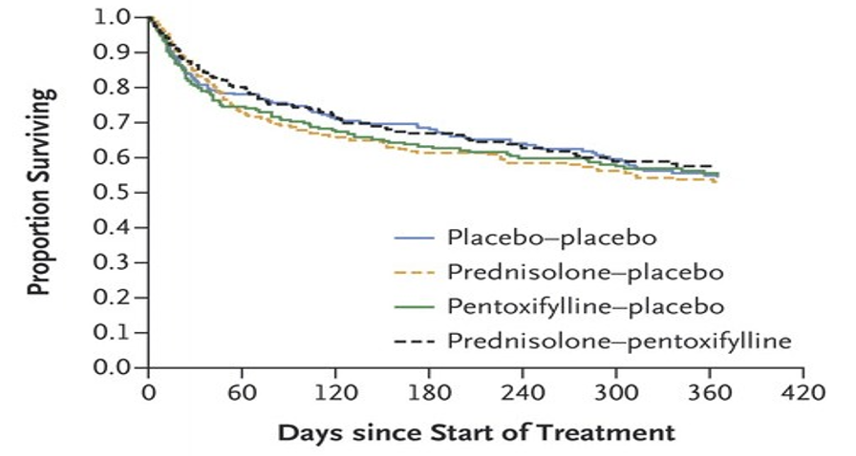
STeroids Or Pentoxifylline for Alcoholic Hepatitis
Infections were twice as common in prednisolone group (P = 0.002)!
Thursz, NEJM 2015

Slide 30
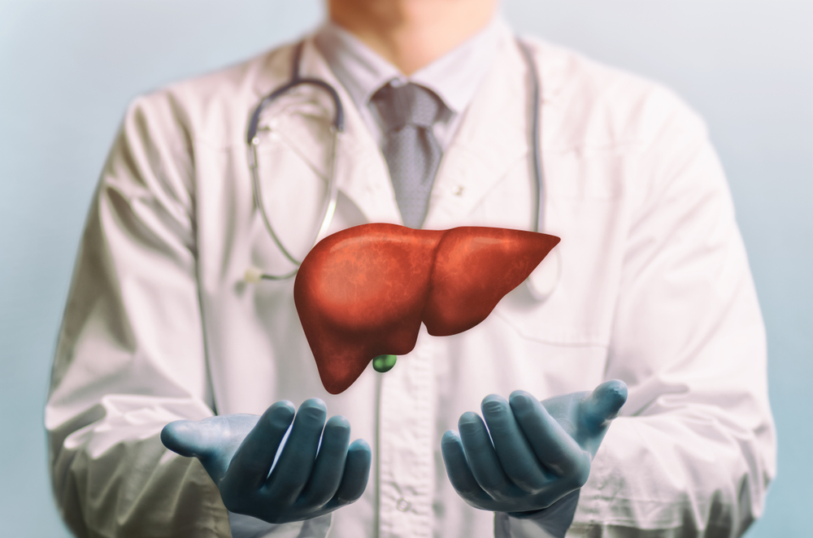
My Patient is Not Recovering: is Transplant an Option?
Limited Sobriety Pathways
Lack of stable social support
Lack in insight
Failure at prior attempts to established sobriety
Continued use despite being counseled to stop
Lack of adequate coping skills
Drinking despite problems at work, home of school
Failure at structured addiction treatment programs
Multiple substance use disorder
DUI or other legal consequences

Slide 31
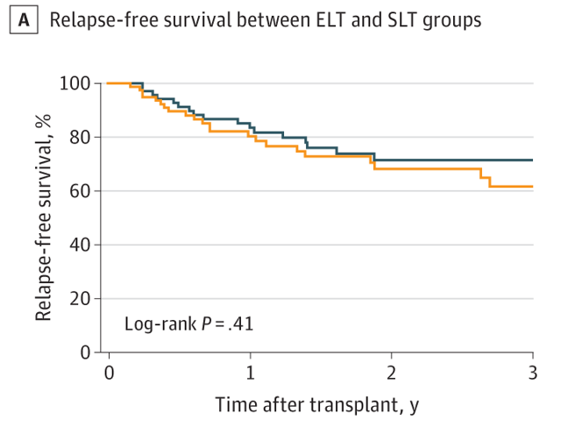
Early vs Standard Liver Transplant for Alcohol-Associated Liver Disease: Survival and Relapse Rates
JAMA Surg. 2021;156(11):1026-1034. doi:10.1001/jamasurg.2021.3748

Slide 32
Impact of Minimum Unit Pricing in British Colombia
Sheron N. J Hepatol 2016;64:957−67;
EASL CPG ALD. J Hepatol 2018;69:154–81
Notes:
CPI, consumer price index

Slide 33
Key takeaways:
Societal disruptions due to COVID-19 pandemic led to increase in harmful alcohol consumption
Admissions for alcohol-related liver disease have skyrocketed
The impact of COVID-19 and harmful patterns of drinking will likely be long lasting
Expertise is needed in management of acute and chronic complications of alcohol related liver disease
Non-pharmacological/psychosocial management of the addictive process is key to long term success

Slide 34
Marina Roytman
Marina.Roytman@ucsf.edu

